Slide 1
YOLOv4: Optimal Speed and Accuracy of Object Detection
Paper Link
Reading notes
Hao Tsui
Notes:
Reference:
[Backbone]
* DenseNet: https://www.youtube.com/watch?v=-W6y8...
* Cross stage partial connections (CSP): https://arxiv.org/abs/1911.11929
* YOLOv3-spp: https://arxiv.org/abs/1903.08589
[Bag of Freebies]
* SAT: https://www.youtube.com/watch?v=v8U9m...
* DIoU: https://arxiv.org/pdf/1911.08287.pdf
* CBN: https://arxiv.org/abs/2002.05712
[Bag of Specials]
* PAN: https://arxiv.org/abs/1803.01534
* Squeeze-and-Excitation: https://arxiv.org/abs/1709.01507
* Spatial Attention Module: https://eccv2018.org/openaccess/conte...
* SPP: https://arxiv.org/abs/1406.4729
* Mish: https://arxiv.org/pdf/1908.08681.pdf

Slide 2
Agenda
Object detector architecture breakdown
Backbone, neck, head
Bag of freebies (BoF)
Bag of specials (BoS)
YOLOv4 architecture selection
YOLOv4 BoF and BoS selection
Experiments and results

Slide 3
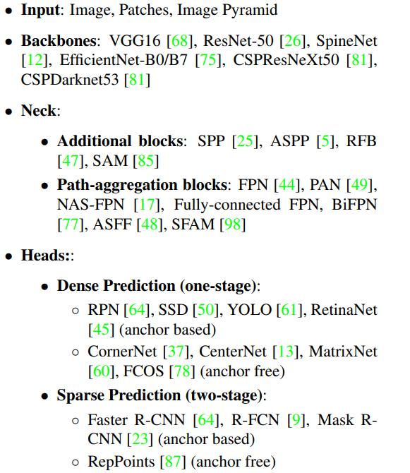
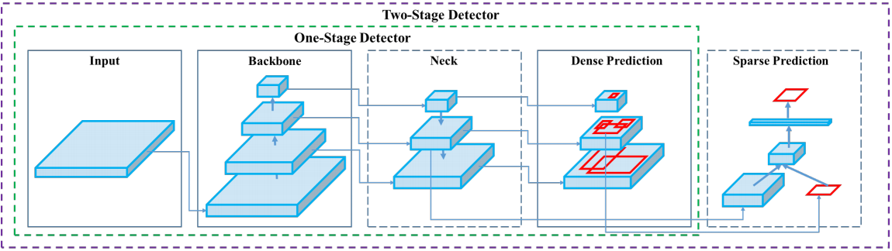
Architecture - breakdown
Common object detector

Slide 4
Backbone / Feature extractor
Executing on different HW
GPU
CPU
VGG
ResNet
ResNeXt
DenseNet
EfficientNet-B0/B7
CSPResNeXt50
CSPDarkNet53
SqueezeNet
MobileNet
ShuffleNet
Notes:
CSP: Cross-Stage-Partial-connections: https://arxiv.org/abs/1911.11929
DenseNet: https://www.youtube.com/watch?v=-W6y8xnd--U

Slide 5
Neck (subset of bag of specials)
Collect feature maps from different stages
Additional block
Path-aggregation blocks
SPP
ASPP
RFB
SAM
FPN
PAN
NAS-FPN
Fully-connected FPN
BiFPN
ASFF
SFAM
Notes:
PAN:

Slide 6
Head / Object detector
Region-based or Anchor-based
Two-stage / Sparse prediction
One-stage / dense prediction
RCNN
Fast RCNN
Faster RCNN
R-FCN
Anchor-free
RepPoints
YOLO
SSD
RetinaNet
Anchor-free
CenterNet
CornerNet
MatrixNet
FCOS

Slide 7
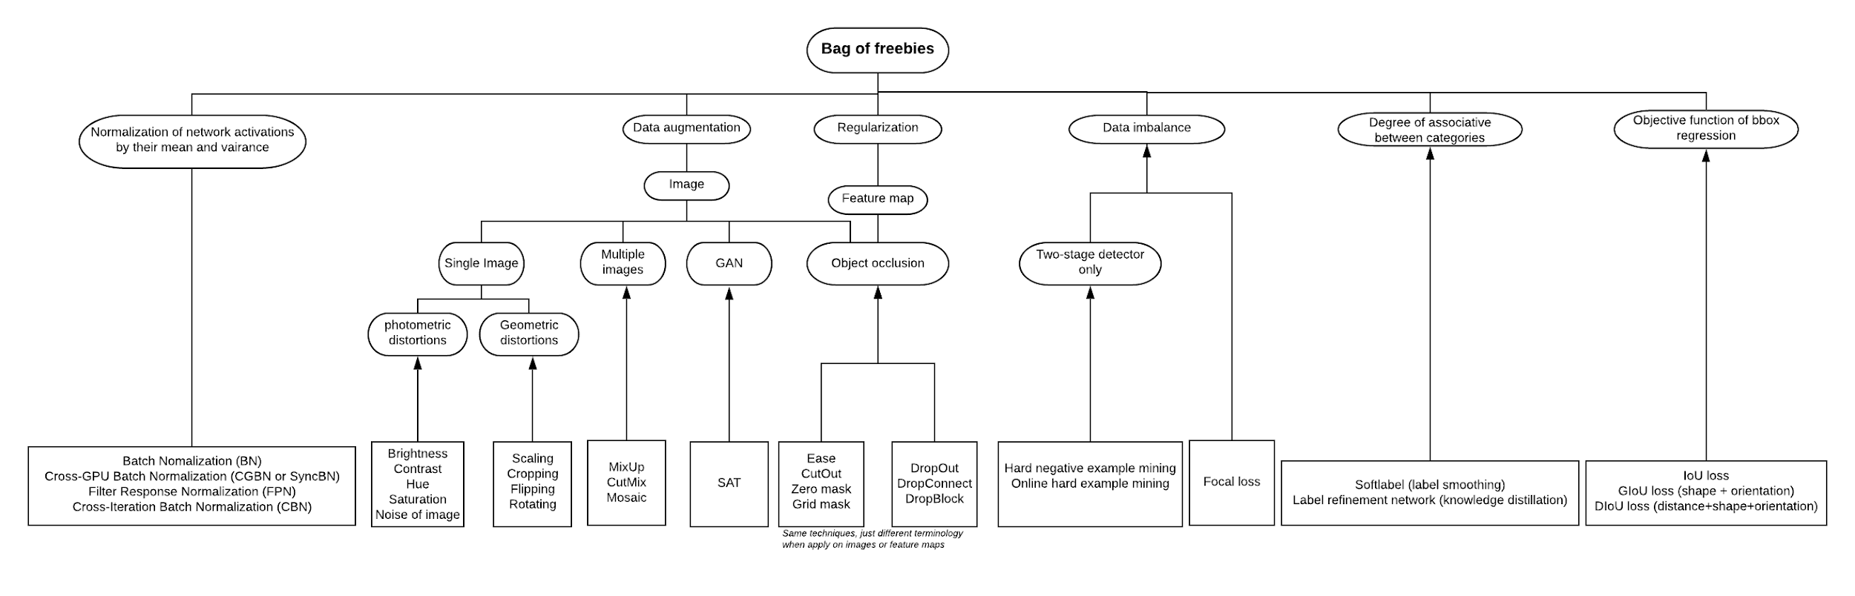
Bag of freebies
Methods that only change the training strategy or only increase the training cost (nothing to do with inference)
Higher resolution image [Link]
Notes:
Data augmentation: increase the variability of the input images
DIoU: https://arxiv.org/pdf/1911.08287.pdf
CBN: https://arxiv.org/abs/2002.05712
IoU can not tell the direction to improve when the prediction and ground truth do not overlap. G IoU solve this problem. But GIoU (Generalize) is not that efficient to converge. DIoU (Distance) and finally the CIoU (complete) is proposed

Slide 8
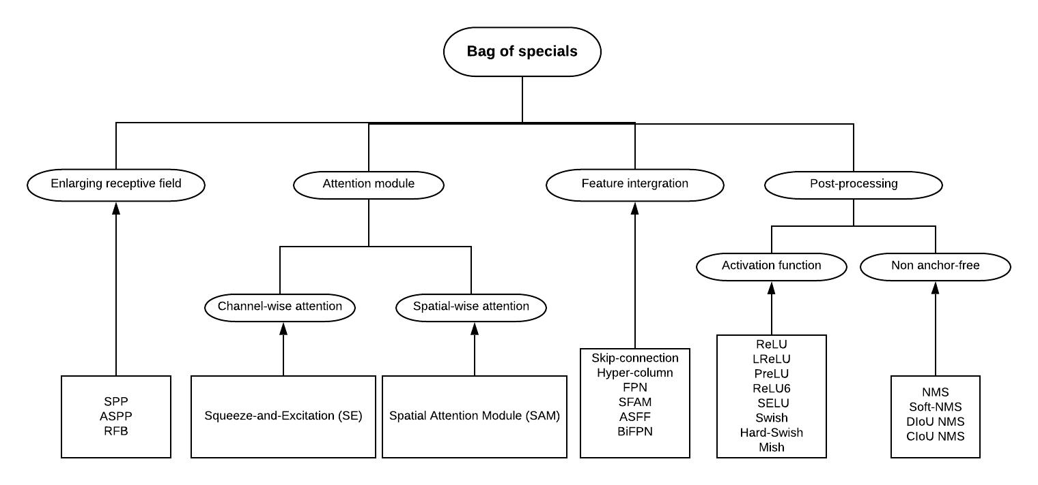
Bag of specials
Plugin modules and post-processing methods that only increase the inference cost by a small amount but can significantly improve the accuracy
Higher resolution image [Link]
Notes:
Squeeze-and-Excitation: https://arxiv.org/abs/1709.01507
Pay 2% extra calculation in ResNet50 but increase 1% top-1 accuracy (ImageNet)
Spatial Attention Module: https://eccv2018.org/openaccess/content_ECCV_2018/papers/Sanghyun_Woo_Convolutional_Block_Attention_ECCV_2018_paper.pdf
Pay 0.1% extra calculation in ResNet50-SE but increase 0.5% top-1 accuracy (ImageNet)
SPP:
https://arxiv.org/abs/1406.4729
https://www.youtube.com/watch?v=2IoHC_fhrFU
Activation: A good activation function can make the gradient more efficiently propagated
LReLU, PReLU: Solve ReLU < 0 area
ReLU6, hard-Switch: Quantization network
SELU: Self-normalizing
Mish: https://arxiv.org/pdf/1908.08681.pdf
NMS:
SoftNMS: solve the problem the occluded objects may cause degradation in NMS
DIoU NMS: adding center point distance to Bbox of SoftNMS
Skip-connections:
Residual connections
Weighted residual connections
Multi-input weighted residual connection
Cross stage partial connections (CSP): https://arxiv.org/abs/1911.11929

Slide 9
Architecture selection criteria
Optimal balance among
Input network resolution (input image size)
Number of convolution layers
Number of parameters
Number of output layers (filters)
Additional blocks for
increase receptive field (bag of specials)
Best method for parameter aggregation from diff. Backbone levels to diff. Detector levels (Necks)

Slide 10
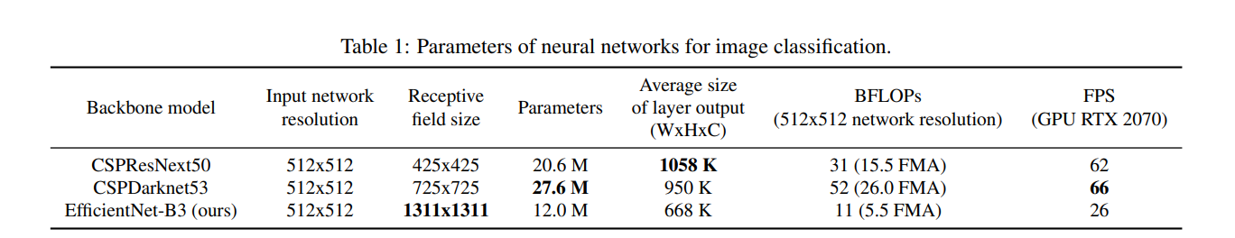
Final architecture
Optimal balance among
Input network resolution
Number of convolution layers
Number of parameters
Number of output layers (filters)
Additional blocks for
increase receptive field (bag of specials)
Best method for parameter aggregation from diff. Backbone levels to diff. Detector levels (Necks)
Backbone: CSPDarknet53
Neck: SPP + PANet
Head: YOLOv3

Slide 11
Why higher resolution?
In contrast to the classifier, detector requires
Higher input network size: for detecting multiple small-sized objects
More layers: for a higher receptive field to cover the increase size of input network
More parameters: for greater capacity of a model to detect multiple objects of different sizes in a single images
The impact of receptive field size
The influence of the receptive field with different size
Up to the object size - allows viewing the entire object
Up to the network size - allows viewing the context around the object
Exceeding the network size - increases the number of connections between the image point and the final activation

Slide 12
Selection of BoF and BoS
Backbone
Detector
BoF:
Data augmentation
Mosaic, CutMix
Regularization
DropBlock
Class label smoothing
BoS:
Mish activation
Cross-stage partial connections (CSP)
Multi-input weighted residual connections (MiWRC)
BoF:
Data augmentation
Mosaic
Self-Adversarial Training
CIoU-loss
CmBN
Eliminate grid sensitivity
Multiple anchors for a single ground truth
Cosine annealing scheduler
Optimal hyper-parameters
Random training shapes
BoS:
Mish activation
SPP-block
SAM-block
PAN path-aggregation block
DIoU-NMS
Notes:
Why CmBN not in the backbone? -> CSPDarkNet53 contains BN layers already.
SAT: https://www.youtube.com/watch?v=v8U9mM1Vwv0

Slide 13
Selection of BoF and BoS
Backbone
Detector
BoF:
Data augmentation
Mosaic, CutMix
Regularization
DropBlock
Class label smoothing
BoS:
Mish activation
Cross-stage partial connections (CSP)
Multi-input weighted residual connections (MiWRC)
BoF:
Data augmentation
Mosaic
Self-Adversarial Training
CIoU-loss
CmBN
Eliminate grid sensitivity
Multiple anchors for a single ground truth
Cosine annealing scheduler
Optimal hyper-parameters
Random training shapes
BoS:
Mish activation
SPP-block
SAM-block
PAN path-aggregation block
DIoU-NMS
Notes:
The slides will cover the highlighted green part

Slide 14
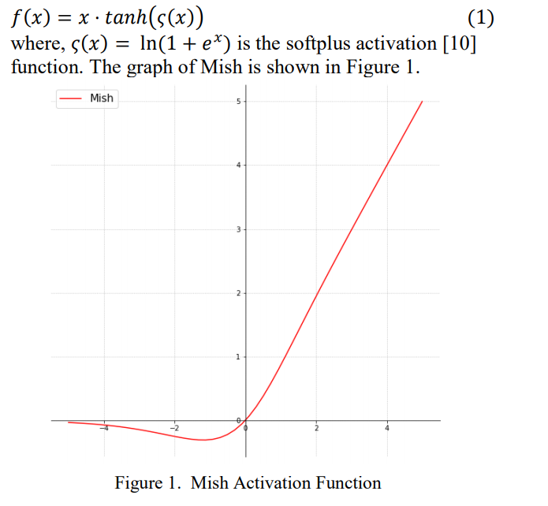
Mish
BoS - Backbone
Notes:
Mish: https://arxiv.org/pdf/1908.08681.pdf
The experiments show that Mish tends to work better than both ReLU and Swish along with other standard activation functions in many deep networks across challenging datasets

Slide 15
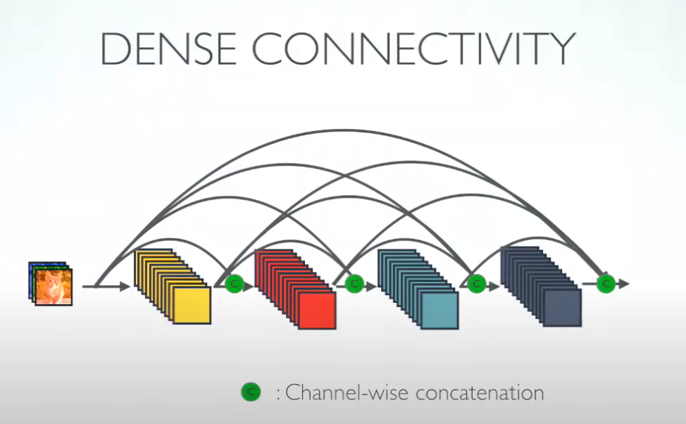
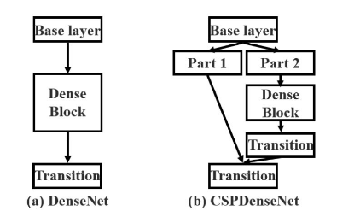
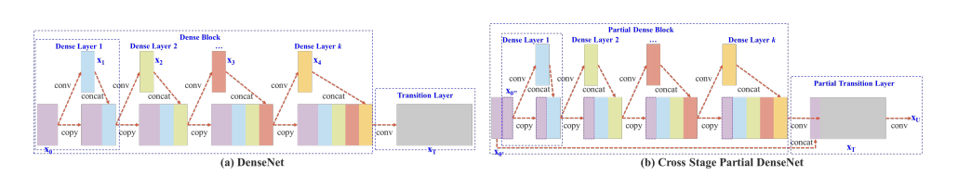
CSP: Cross-Stage Partial Connection
BoS - Backbone
DenseNet
CSPDenseNet
Notes:
DenseNet: https://www.youtube.com/watch?v=-W6y8xnd--U
Advantage 1: strong gradient flow, the error signal can be backprob easily to the early layers
Advantage 2: less parameters
Advantage 3: Diversified features
Advantage 4: The final classifier has all level of features (smoother decision boundary, a better performance)
Imply that DenseNet works well when training data is insufficient
Cross stage partial connections (CSP): https://arxiv.org/abs/1911.11929
- DenseNet has duplicated gradient information which can be improved
- Cross-Stage Partial composite with 2 parts: 1. Partial Dense Block 2. Partial Transition Layer.
The benefits of CSP is mainly come from "splitting the gradient flow"
* strengthen the learning capability (even a lightweight model (less params) can achieve similar accuracy, but much faster)
* removing the bottleneck layer
* reduce memory costs (use channel-wise compression during the feature pyramid (EFM model))

Slide 16
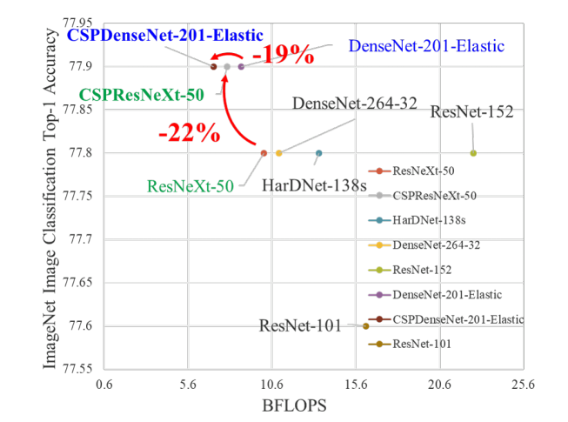
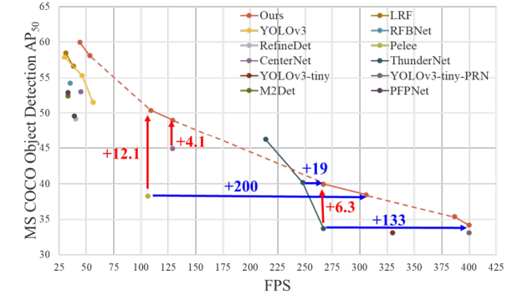
CSP: Cross-Stage Partial Connection
BoS - Backbone

Slide 17
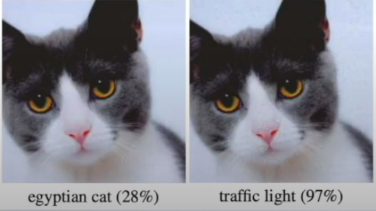
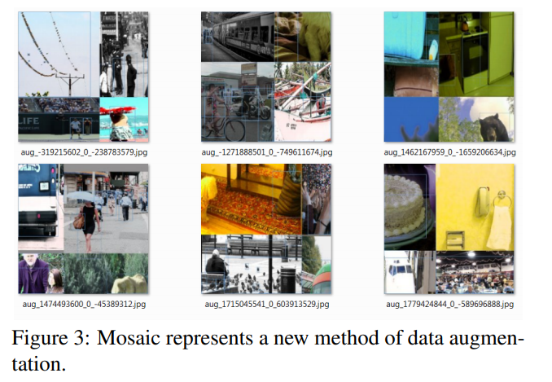
YOLOv4 data augmentation
Mosaic (new)
Allows detection of objects outside their normal context
Batch normalization calculates activation statistics from 4 different images -> reduce need for large mini-batch size
Self-Adversarial Training (SAT)
2 forward backward stage
1. Altering the original image
2. Normal altering weights
CutMix mixes 2, Mosaic mixes 4
Notes:
SAT: https://www.youtube.com/watch?v=v8U9mM1Vwv0

Slide 18
YOLOv4 modified stuffs
Modified
Spatial Pyramid Pool (SPP)
Spatial Attention Module (SAM)
Path Aggregation Network (PAN)
Cross-Iteration Batch Normalization (CBN)
Notes:
SAT: https://www.youtube.com/watch?v=v8U9mM1Vwv0

Slide 19
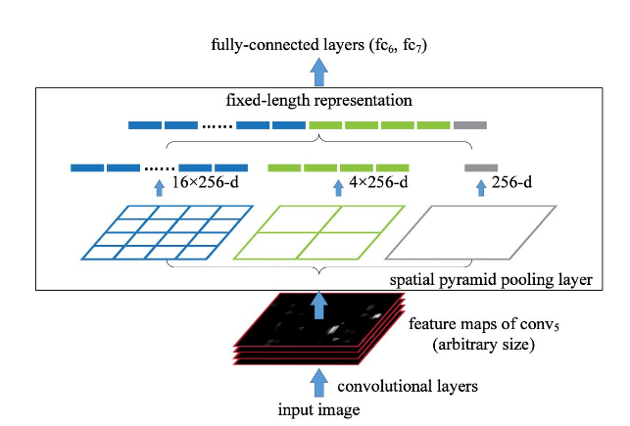
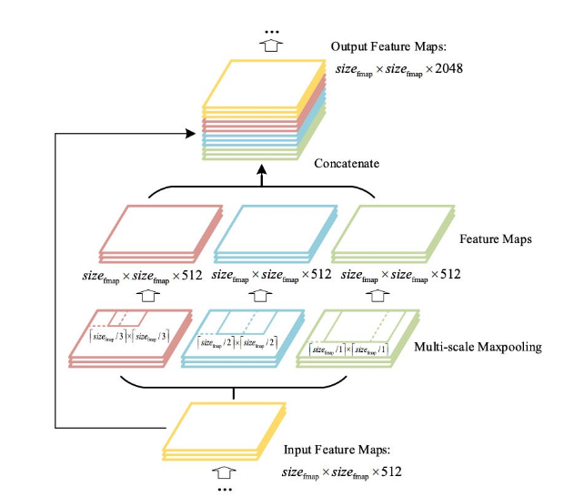
SPP: Spatial Pyramid Pooling
BoS - Neck
Original SPP
Modified SPP
Maxpool, stride=1,
with padding
Notes:
YOLOv3 - SPP: https://drive.google.com/file/d/1zA79u9cxwJqGNXGSzFd9ouqAgUvlm2W-/view

Slide 20
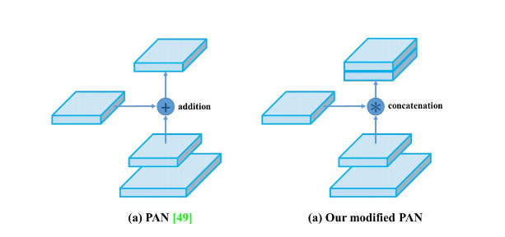
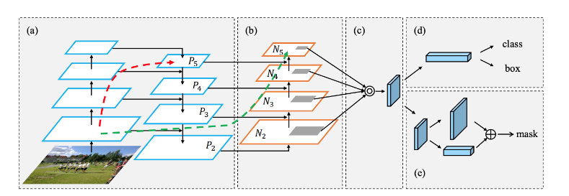
PAN: Path Aggregation Network
BoS - Neck
Original PAN
Modified PAN
concatenation
Notes:
* PAN: https://arxiv.org/abs/1803.01534 A bottom-up path (b) is augmented to make low-layer information easier to propagate to the top. In FPN, the localized spatial information traveled upward in the red arrow. While not clearly demonstrates in the diagram, the red path goes through about 100+ layers. PAN introduced a short-cut path (the green path) which only takes about 10 layers to go to the top N₅ layer. This short-circuit concepts make fine-grain localized information available to top layers
In FPN, objects are detected separately and independently at different scale levels. This may produce duplicated predictions and not utilize information from other feature maps. PAN fuses the information together from all layers first using element-wise max operation

Slide 21
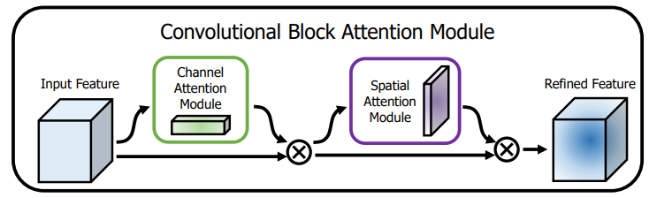
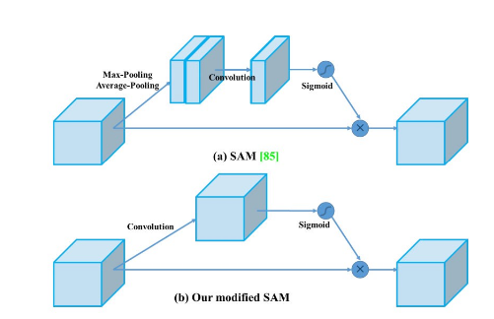
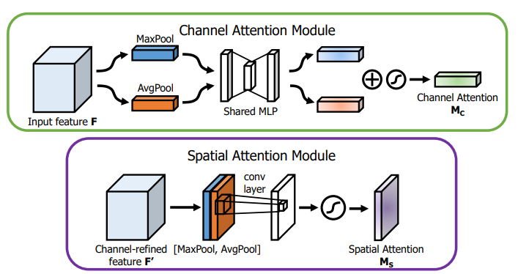
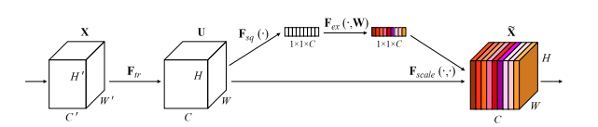
SAM: Spatial Attention Module
BoS - Neck
Original *CBAM
Modified SAM
point-wise
Original SE
Along the channel
Not efficient on GPU!
Notes:
Squeeze-and-Excitation: https://arxiv.org/abs/1709.01507
Pay 2% extra calculation in ResNet50 but increase 1% top-1 accuracy (ImageNet)
Spatial Attention Module: https://eccv2018.org/openaccess/content_ECCV_2018/papers/Sanghyun_Woo_Convolutional_Block_Attention_ECCV_2018_paper.pdf
Pay 0.1% extra calculation in ResNet50-SE but increase 0.5% top-1 accuracy (ImageNet)
*CBAM (Convolutional Block Attention Module): https://eccv2018.org/openaccess/content_ECCV_2018/papers/Sanghyun_Woo_Convolutional_Block_Attention_ECCV_2018_paper.pdf
Original CBAM is sequential order: Channel-wise -> Spatial-wise
Spatial-wise first apply the “max” and “average” pool along the “channels”

Slide 22
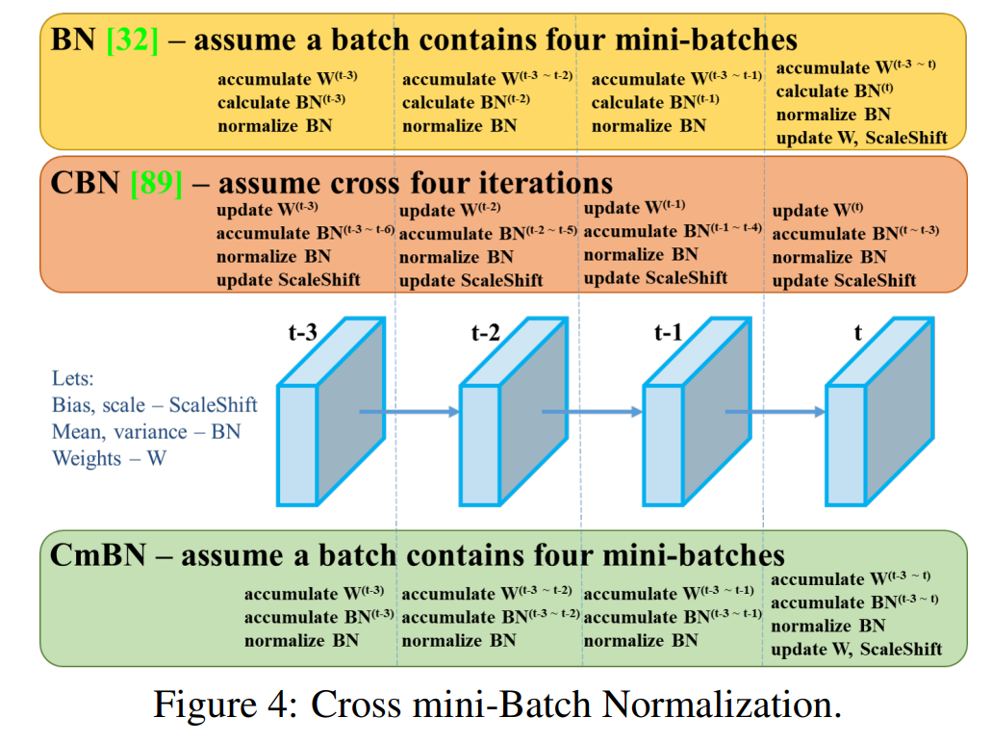
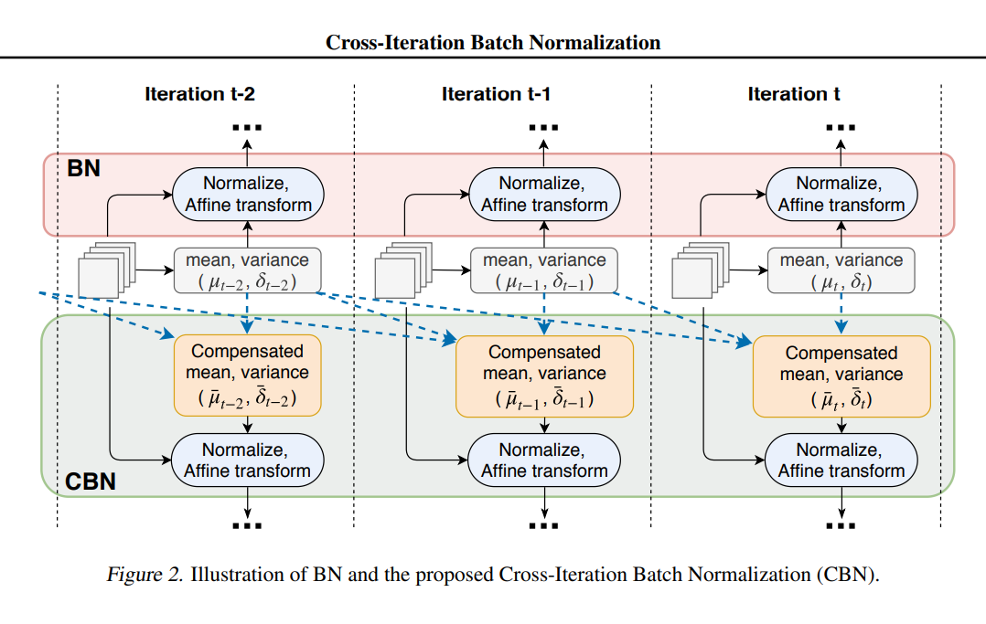
CBN: Cross-Iteration Batch Normalization
BoF
Original CBN
Modified CBN
Collects statistics only between mini-batches within a single batch
Notes:
Cross-Iteration Batch Normalization [Link]: Paper: https://arxiv.org/pdf/2002.05712.pdf
try to solve the problem of small mini-batch size problem of original batch normalization by “collecting the stats from previous iteration” (same layer!)
The key assumption is: Taylor expansion!

Slide 23
Dataset
ImageNet -> Classifier
MS COCO 2017 -> Detector

Slide 24
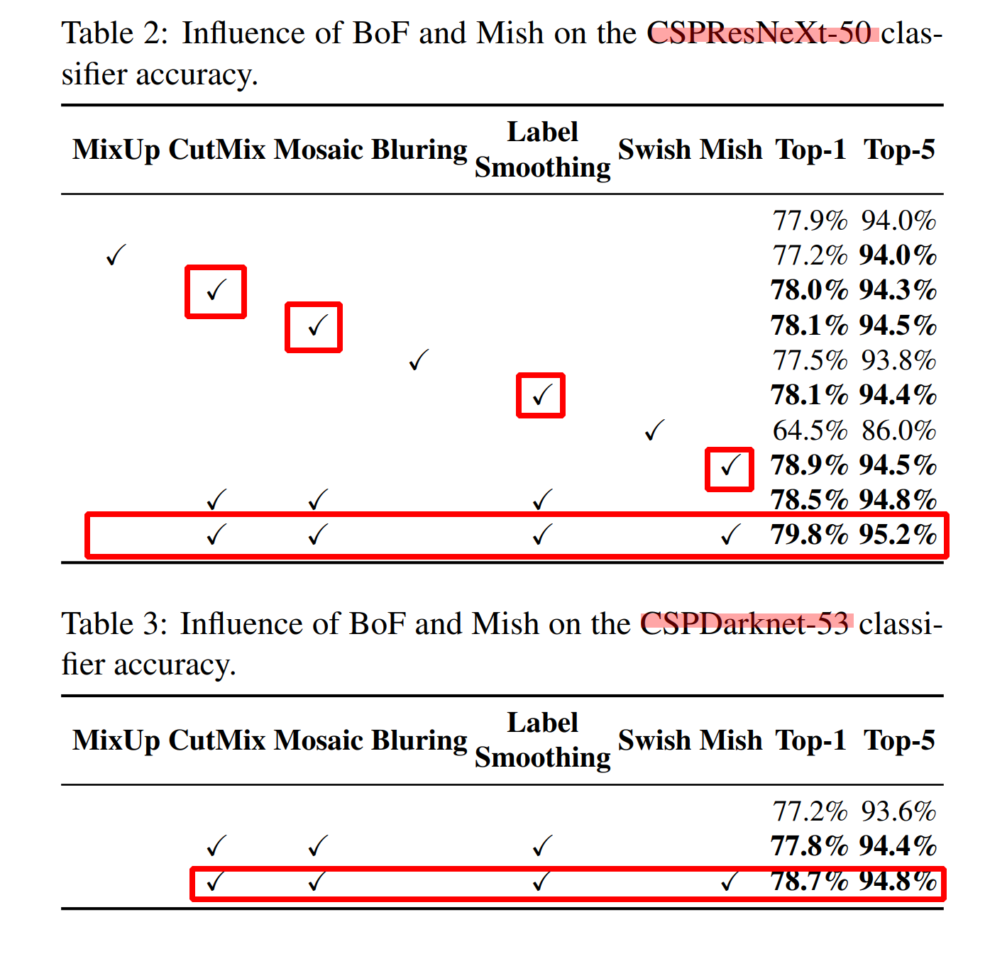
Influence of BoF and Activation on Classifier
CSPResNeXt outperform CSPDarkNet on classifier

Slide 25
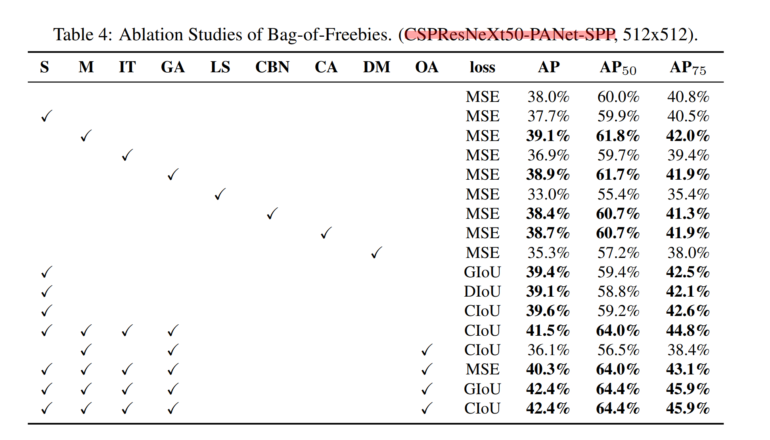
Influence of BoF on Detector
S: Eliminate grid sensitivity
M: Mosaic
IT: IoU threshold
GA: Genetic algorithms
LS: Class label smoothing
CBN: Cross mini-batch normalization
CA: Cosine annealing scheduler
DM: Dynamic mini-batch size
OA: Optimized anchors
MSE: Mean Square Error
GIoU: (shape+orientation)
DIoU: (distance + shape+ orientation)

Slide 26
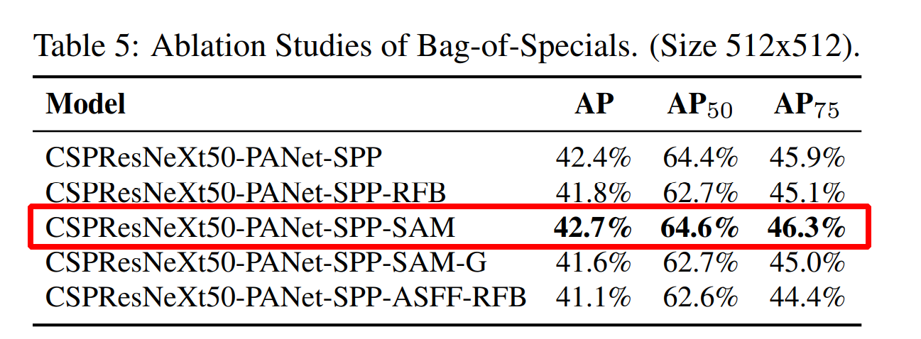
Influence of BoS on Detector

Slide 27
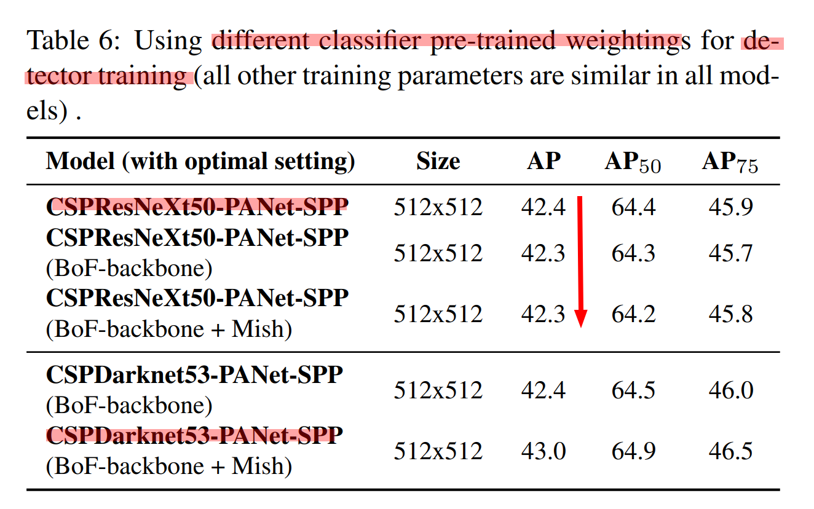
Influence of Backbone on Detector
CSPDarkNet53 is more suitable for detector
CSPDarkNet outperform CSPResNeXt on detector
Note: previously, table 4 shows CSPResNeXt outperform CSPDarkNet for classifier
Note: previously, table 4 shows CSPResNeXt + BoF + Mish increase classifier accuracy. But here shows decreasing.
Note: CSPDarkNet shows increasing applying BoF + Mish on both classifier and detector
Notes:
Comparing with table 4.
Classifier and Detector conflicts

Slide 28
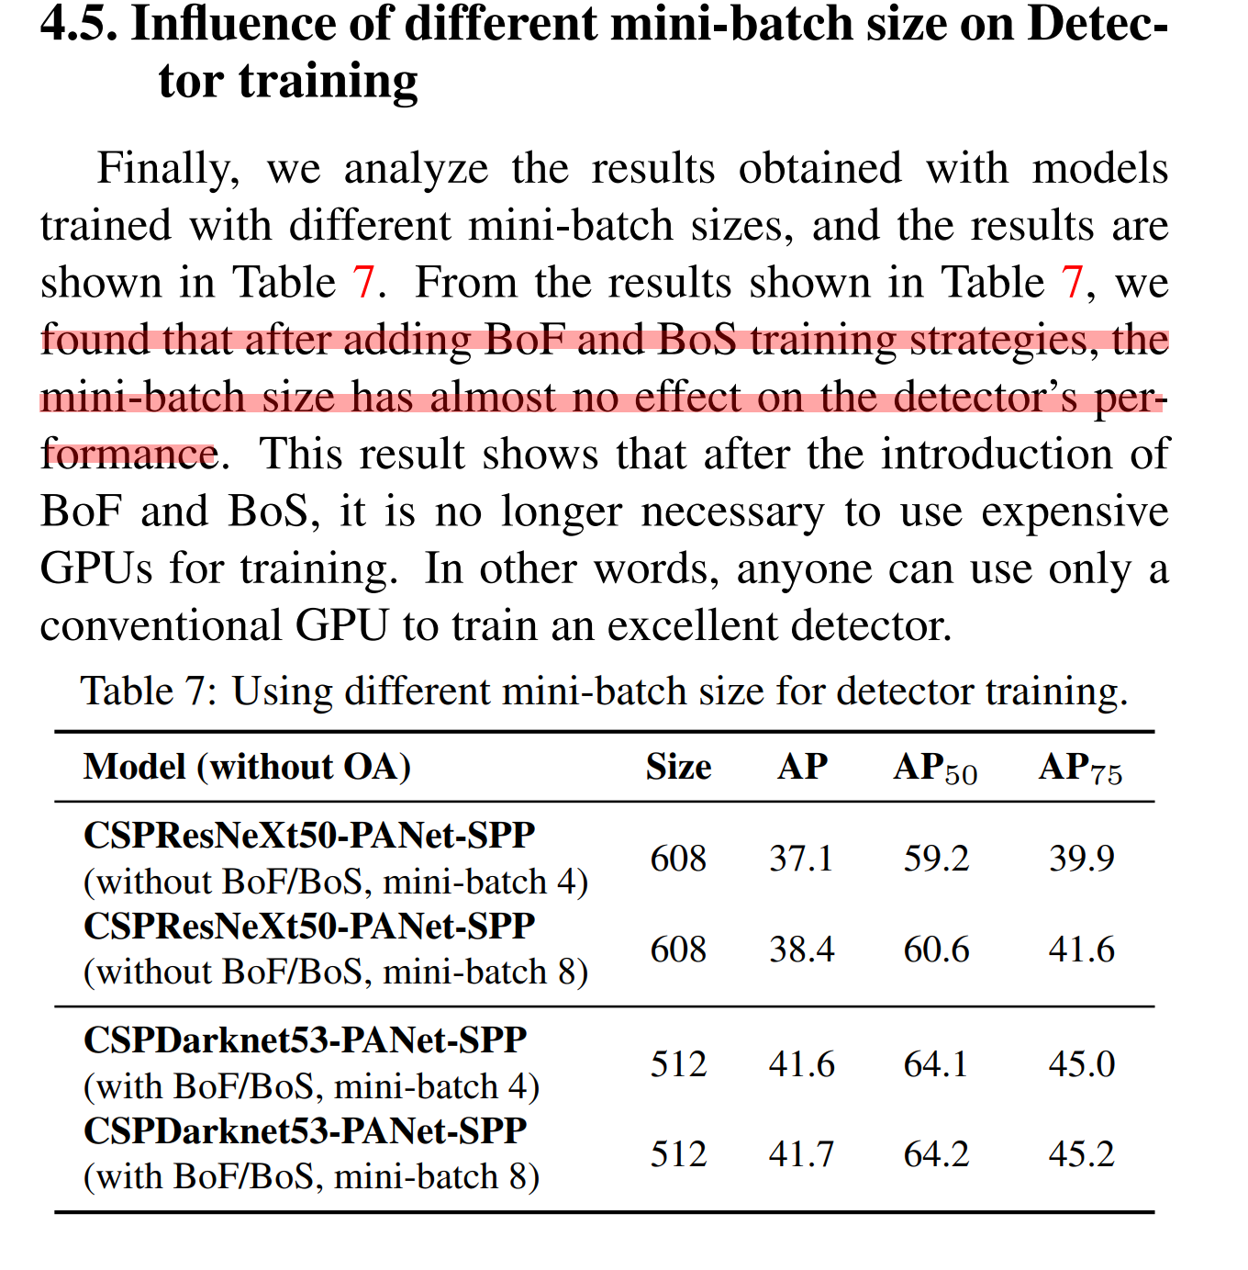
Influence of Mini-batch on Detector
No more additional GPU

Slide 29
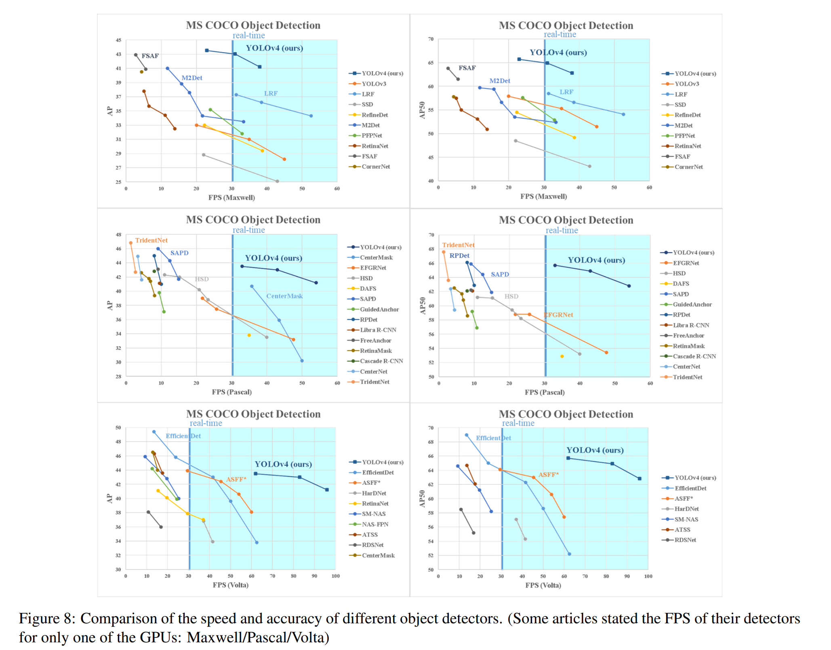

Slide 30
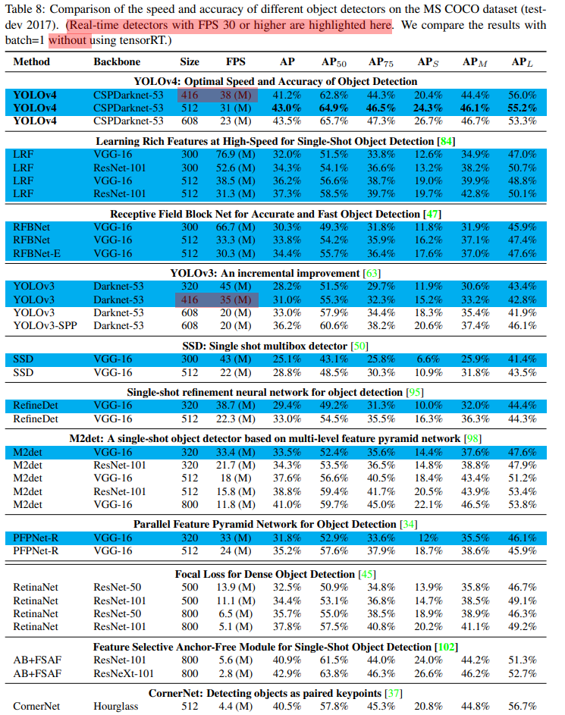
Maxwell

Slide 31
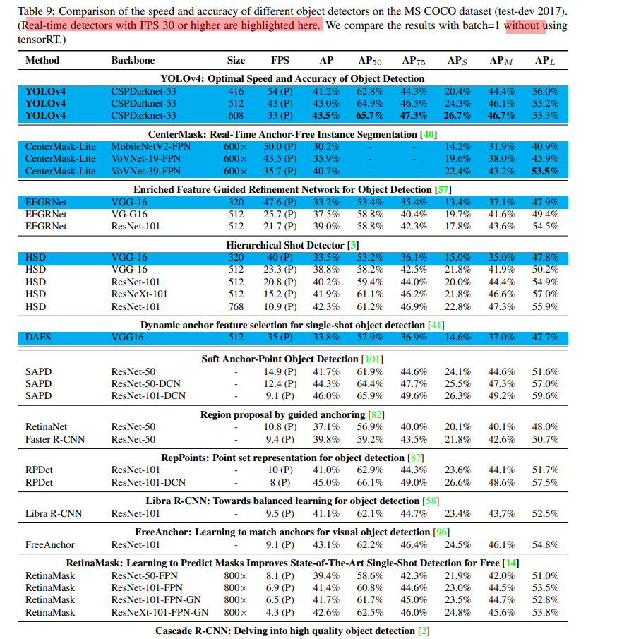
Pascal

Slide 32
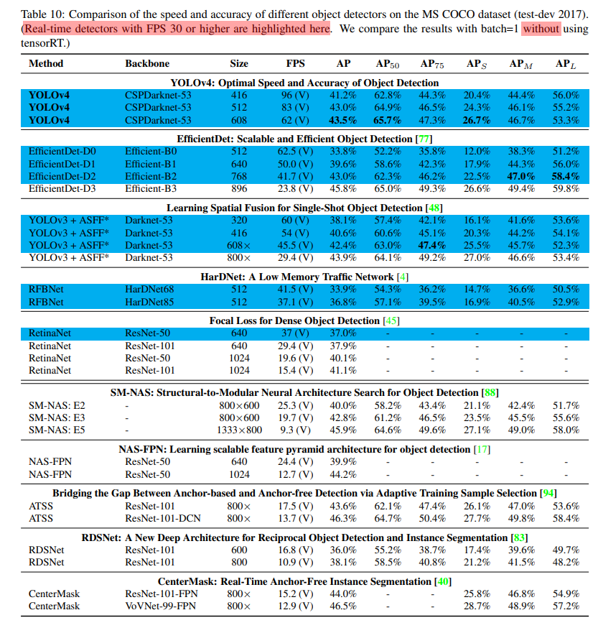
Volta

